Slide 1

WP4
Piloting, evaluation and revision of developed Piloting, evaluation and revision of developed study programmes and courses
WP leaders: Zorica Kuburić (UNS),
Nebojša Majstorović (UNS)
March 16, 2016.

Slide 2
Overall goal of WP4:
To evaluate the effects of the B.A. and M.A programmes on the first generation of students in Social Work and Social Policy enrolled at Universities in Serbia, and
To revise the B.A. and M.A programmes on the ground of the evaluation data collected during the period of this WP.

Slide 3
Deliverables of WP4:
1. The number of students enrolled in B.A., M.A. and Ph.D. study programmes at three Universities in Serbia
2. The Evaluation Questionnaires and Interview protocols developed and distributed
3. The evalaution data collected, analyzed and reported
4. The Social Work and Social Policy study programmes revised and finalized

Slide 4
WP4 detailed action plan:
Planning of activitis within WP4 took place on 28.- 30. May 2015., during workshop/conference at University of Belgrade, Faculty of Political Science.
All partner institutions were present.

Slide 5
WP4 detailed action plan :
Timeline of WP4:
from 30.08. 2015. to 31.08.2016.
WP4 Action plan adopted on SHESPSS team meeting on 1.09.2015.
The UNS evaluation team formed: Nebojša Majstorović, Marija Zotović, Marko Škorić, Svetlana Kostović, Jelena Đermanov, Aleksej Kišjuhas, and Stefan Ninković.
Evaluation coordinators named at each partner University: UBG (Tamara Dzamonja), UNI (Danijela Gavrilović) and UNS (Pavle Milenković).
Main responsibilities of the evaluation team:
  to carry out the WP4 action plan in general,
  to propose and finalize data gathering tools,
  to train evaluators in the application of data gathering tools,
  to coordinate evaluation activities at Partner Universities,
  to gather and organize the data,
  To prepare and analyze evaluation data, and
  To participate in writing of the Evaluation report.

Slide 6
Timeline and status for WP4 activities:
Activity | Date | Status
D4.1.; D4.2.; D4.3. (Enrolling students taught in B.A. and M.A, programmes at UNS and UNI and revised programmes at UBG) | 20.8.2015. - 31.8.2016. | Done
D4.5.1. (Developing the Evaluation procedures) | 20.8.2015. - 31.10.2015. | Done
D4.5.2. (Evaluation procedures training) | 11.01.2016. | Done
D4.5.3. (Evaluation procedures applied at the end of Winter Semester) | January – February 2016. | Done

Slide 7
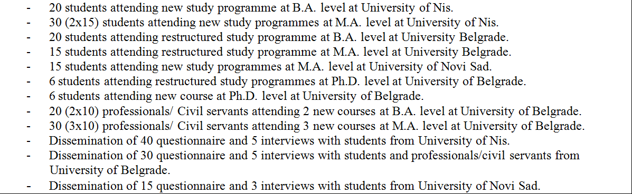
WP4 - Indicators of achievement
and/or performance
The number of students enrolled in B.A., M.A. and Ph.D. study programmes at three Universities in Serbia
(D4.1.; D4.2.; D4.3).:

Slide 8
WP4 - Indicators of achievement and/or performance
D4.5.1. (Developing the Evaluation procedures)
Questionnaires, interview and focus group protocols for courses and programs evaluation were discussed within the evaluation working group and sent to all partners for comments.
Decision was made to administer the questionnaire to all students, to conduct focus group with some students and to interview some professors.
All data gathering tools and consent forms completed by 31. 10.2016. (translated in English by 3.11.2016).
This material posted at: http://www.shespss.ni.ac.rs/downloads/viewcategory/46-evaluation-of-pilot-programs-and-courses
Printed materials available: protocols and Consent forms.

Slide 9
WP4 - Indicators of achievement and/or performance
D4.5.2. (Evaluation procedures training)
The evaluation training was held on 11.01.2016. at premises of the Faculty of Philosophy with evaluation coordinators from all three partner Universities.
All procedures were discussed, understood, all changes accepted and communication line opened for further questions, if needed.
Decided that evaluation coordinators define dates and dynamics of the evaluation process during January and February 2016.

Slide 10
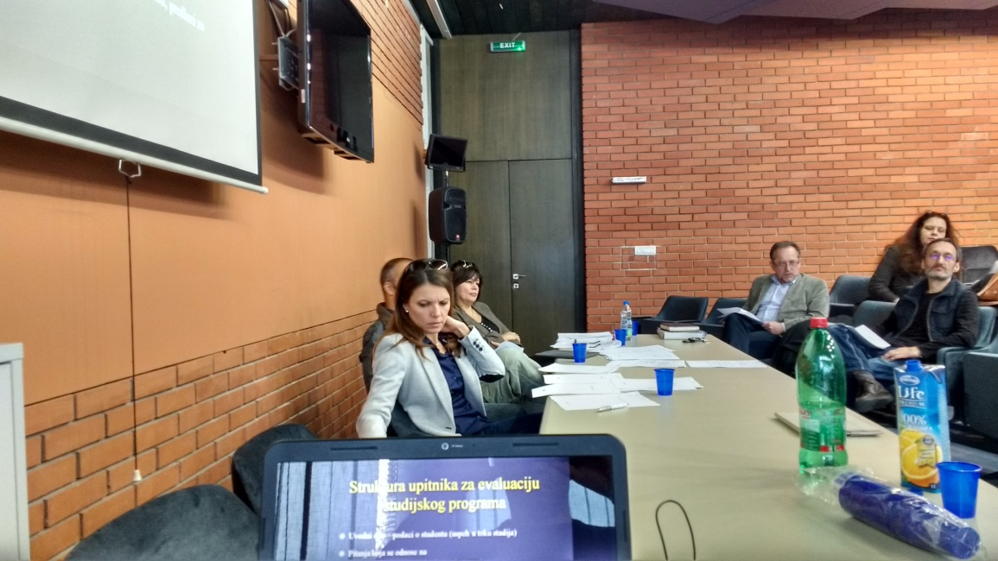
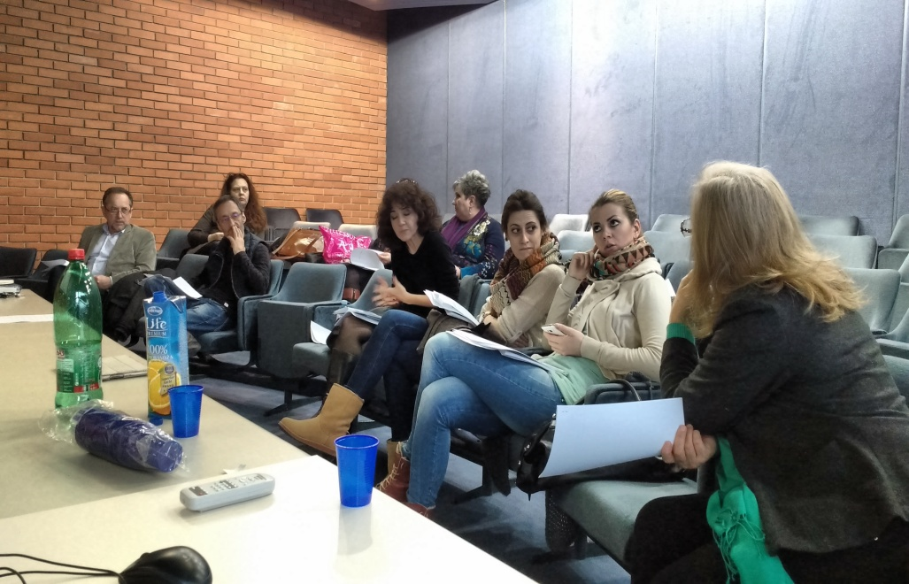
D4.5.2. (Evaluation procedures training)

Slide 11
WP4 - Indicators of achievement and/or performance
D4.5.3. (Evaluation procedures applied at the end of Winter Semester) :
Proveriti broj upitnika zadat studentima i koliko je bilo validno i uneto u matricu (koordinatori po UN to znaju)

Slide 12
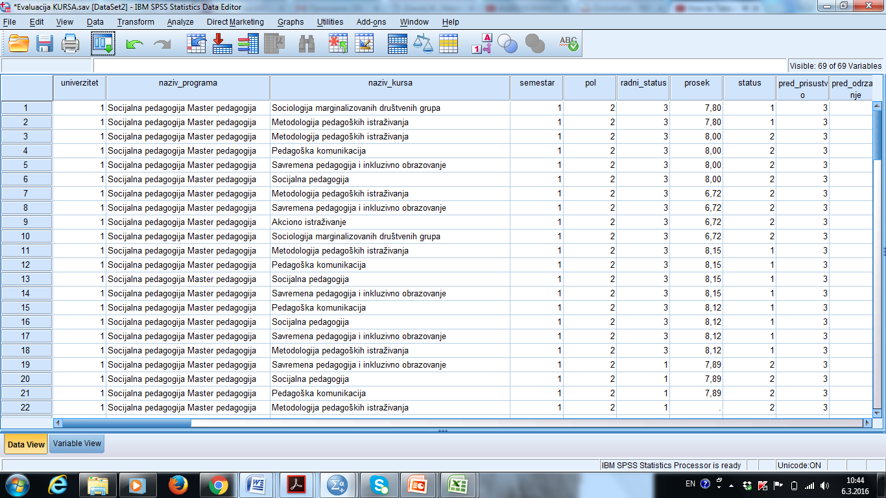
WP4 - Indicators of achievement and/or performance
D4.5.3. (Evaluation procedures applied at the end of Winter Semester) - raw questionnaire data entered into SPSS matrices and delivered in time:

Slide 13
WP4 - Indicators of achievement and/or performance
D4.5.3. (Number of Questionnaires returned from Universities – course evaluation):

Slide 14
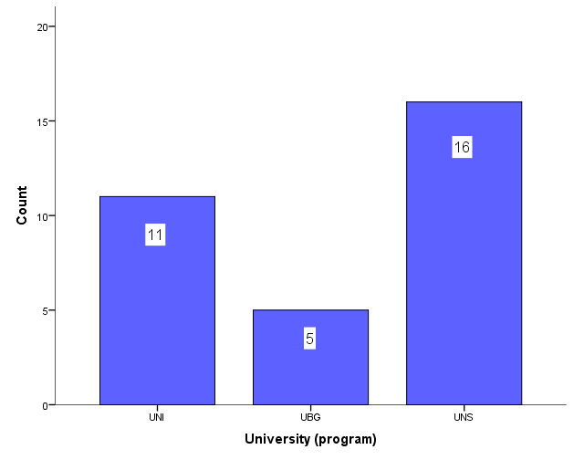
WP4 - Indicators of achievement and/or performance
D4.5.3. (Number of Questionnaires returned from Universities – program evaluation):

Slide 15
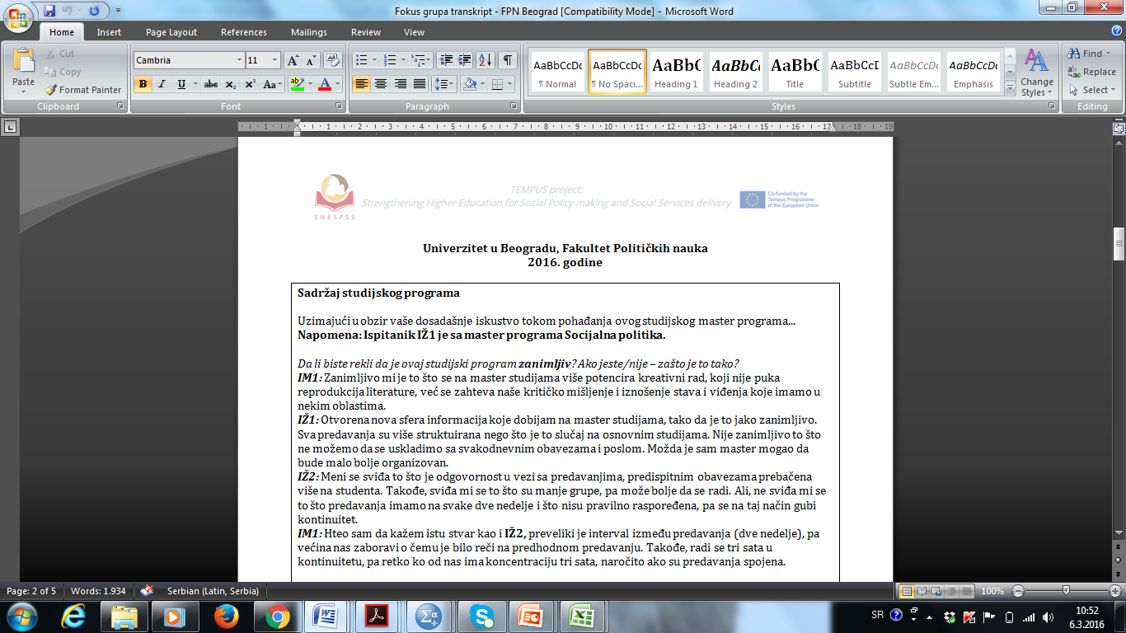
WP4 - Indicators of achievement and/or performance
D4.5.3. (Interview and Focus-groups transcripts received from Universities)
UBG: 4 interviews and 1 focus-group transcripts
UNS: interview transcripts to be delivered, 1 focus-group transcript
UNI: 3 interviews and 1 focus-group transcripts.

Slide 16
WP4 – next activities
Activity | Date | Status
D4.5.4. (Evaluation procedures applied at the end of Summer Semester) | 1.05.2016. - 21.05.2016. | Not done
D4.5.5. (Evaluation data collected, analyzed and interpreted) | 1.06.2016. - 30.06.2015. | Not done
D4.5.6. (Writing the Evaluation Report with proposed revisions) | 1.07.2016. – 15.07.2016. | Not done

Slide 17

Thank you for your attention!

